Slide 1


ECEN 403 Status Update Team 60: Solar Lighting System Josh George, Lyric Haylow, Jeb Malek Sponsor :Dr. Jang

Slide 2

Problem At Hand
As power systems begin to move away from nonrenewable energy sources, a need for a clean, renewable source becomes critical.

Slide 3
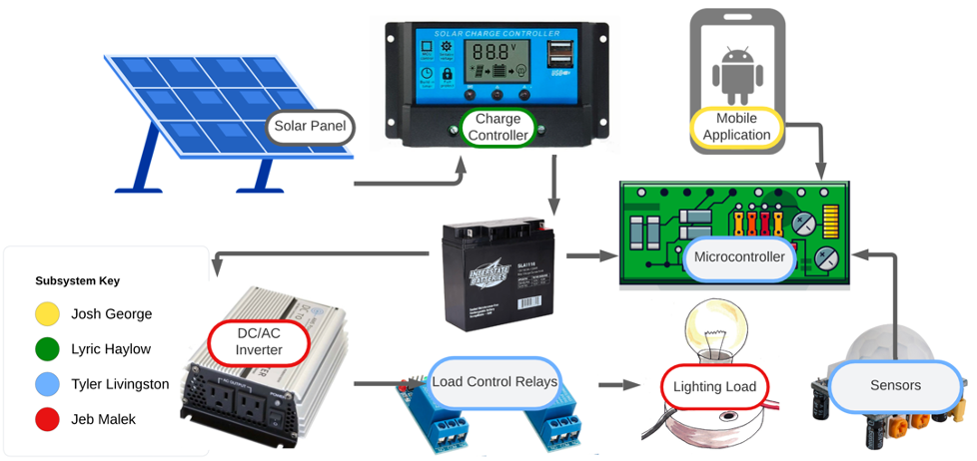
Problem Overview
For our project, we will design a home lighting system that operates a variety of lights throughout both an inside foyer and an outside patio. The separate parts for the system to be considered are the battery, power conversion and regulation, mobile application functionality, BT microcontroller, and motion and light sensors for automated switching.

Slide 4
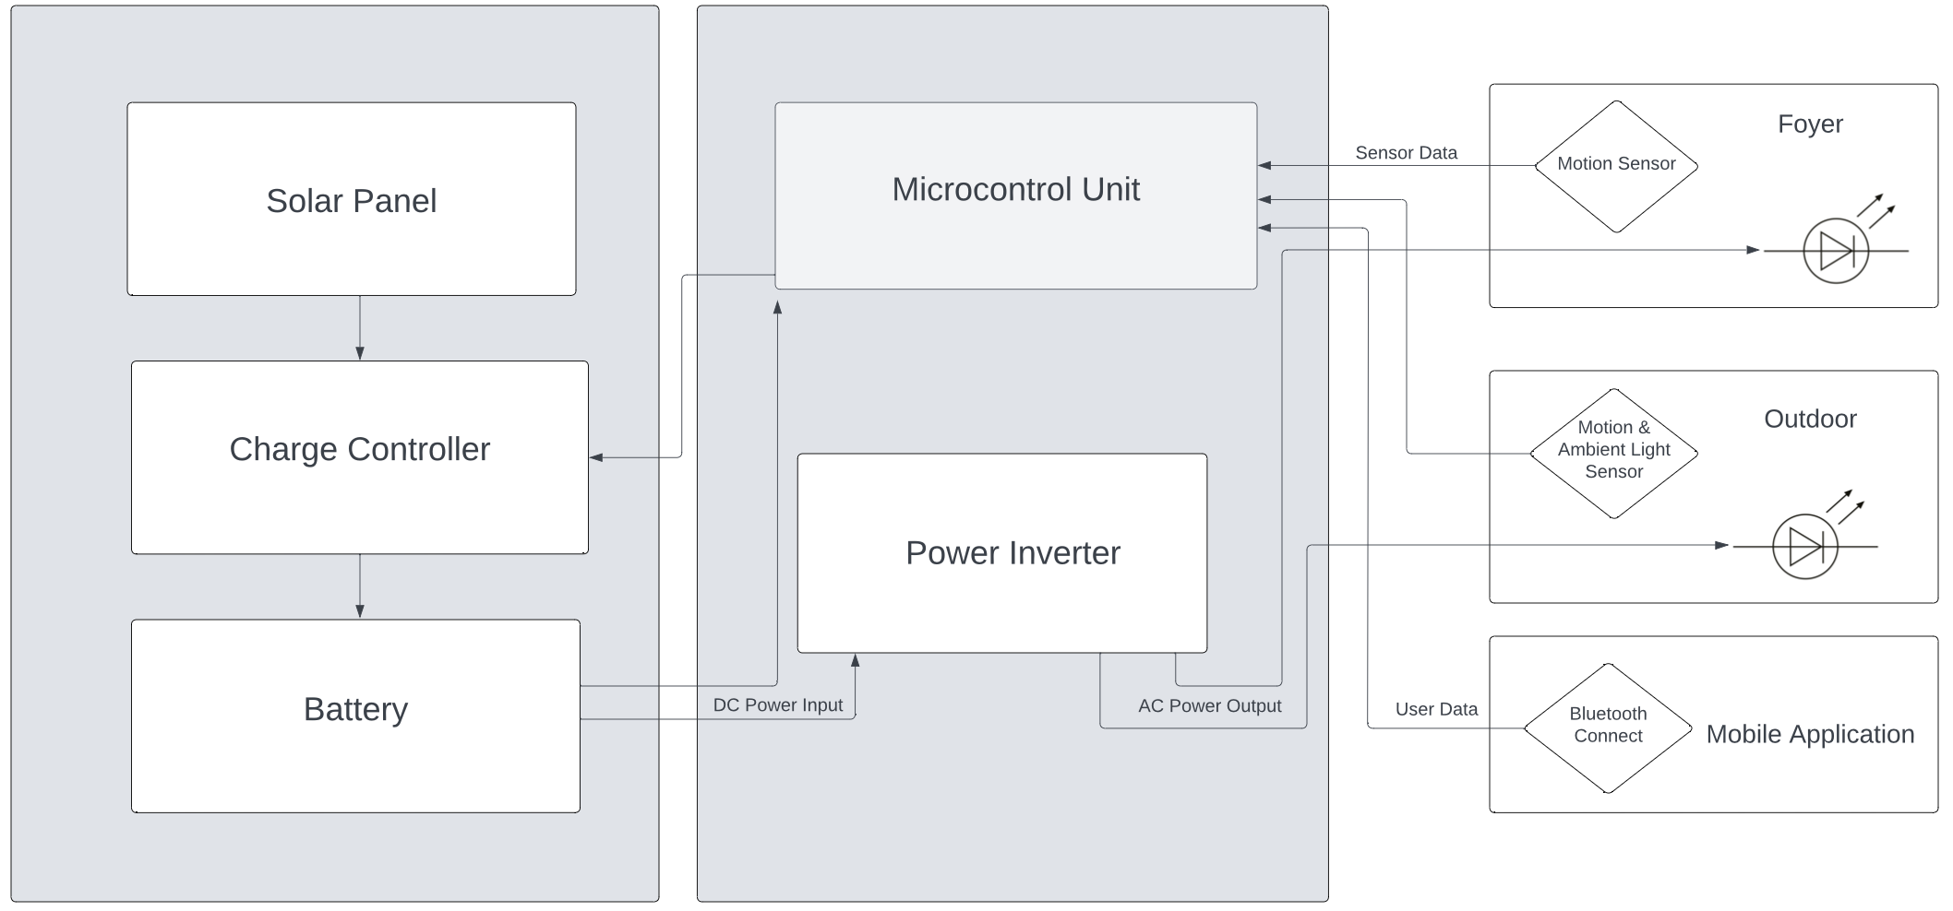
Subsystem Description

Slide 5
Task Partition
Lyric: Design and implement a charge controller to regulate the power that charges the battery from the solar panel.
Jeb: Design a power inverter to send power from the battery to the lights.
Josh: Create a mobile application that can monitor and manipulate the entire lighting system per manual direction.
Tyler: Design and develop a control unit to control lights based on user preference.

Slide 6
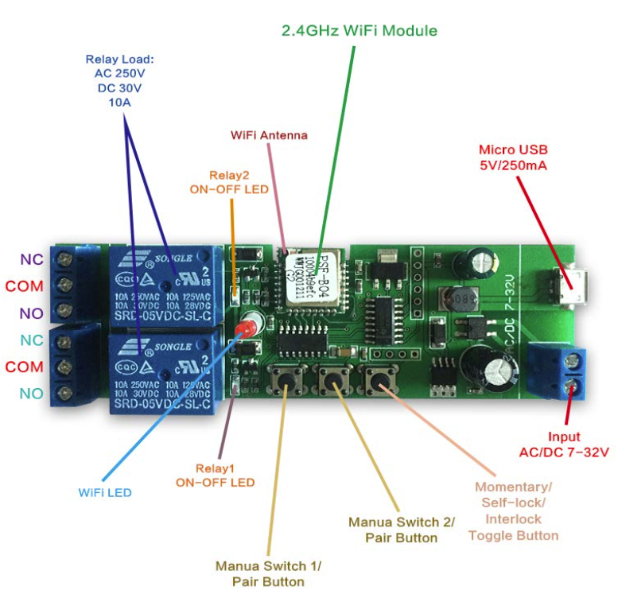
Microcontroller and Sensors
The MCU must take in sensor data and send signals to control the lights based on user preference from the mobile app.

Slide 7
Solar Charge Controller Lyric Haylow
Accomplishments since the last presentation 26.5 hrs | Ongoing progress/problems and plans until the next presentation
Schematic Design finalized Acquired secondary Solar Panel Designated connections from Panel to Controller to Battery PCB Design set | Practice Solder Finalize part values in Schematic Order Parts Test Solar Panel and Battery
Solar Charge Controller:​
Chosen design: BQ24650 Stand-Alone Buck Battery Charge Controller for Solar Power with Maximum Power Point Tracking​
Essentially regulates how much power is being fed to the battery. Buck Battery charge controller ensures that if voltage goes too high or low, adjusts it to fit expected value for the battery. ​

Slide 8
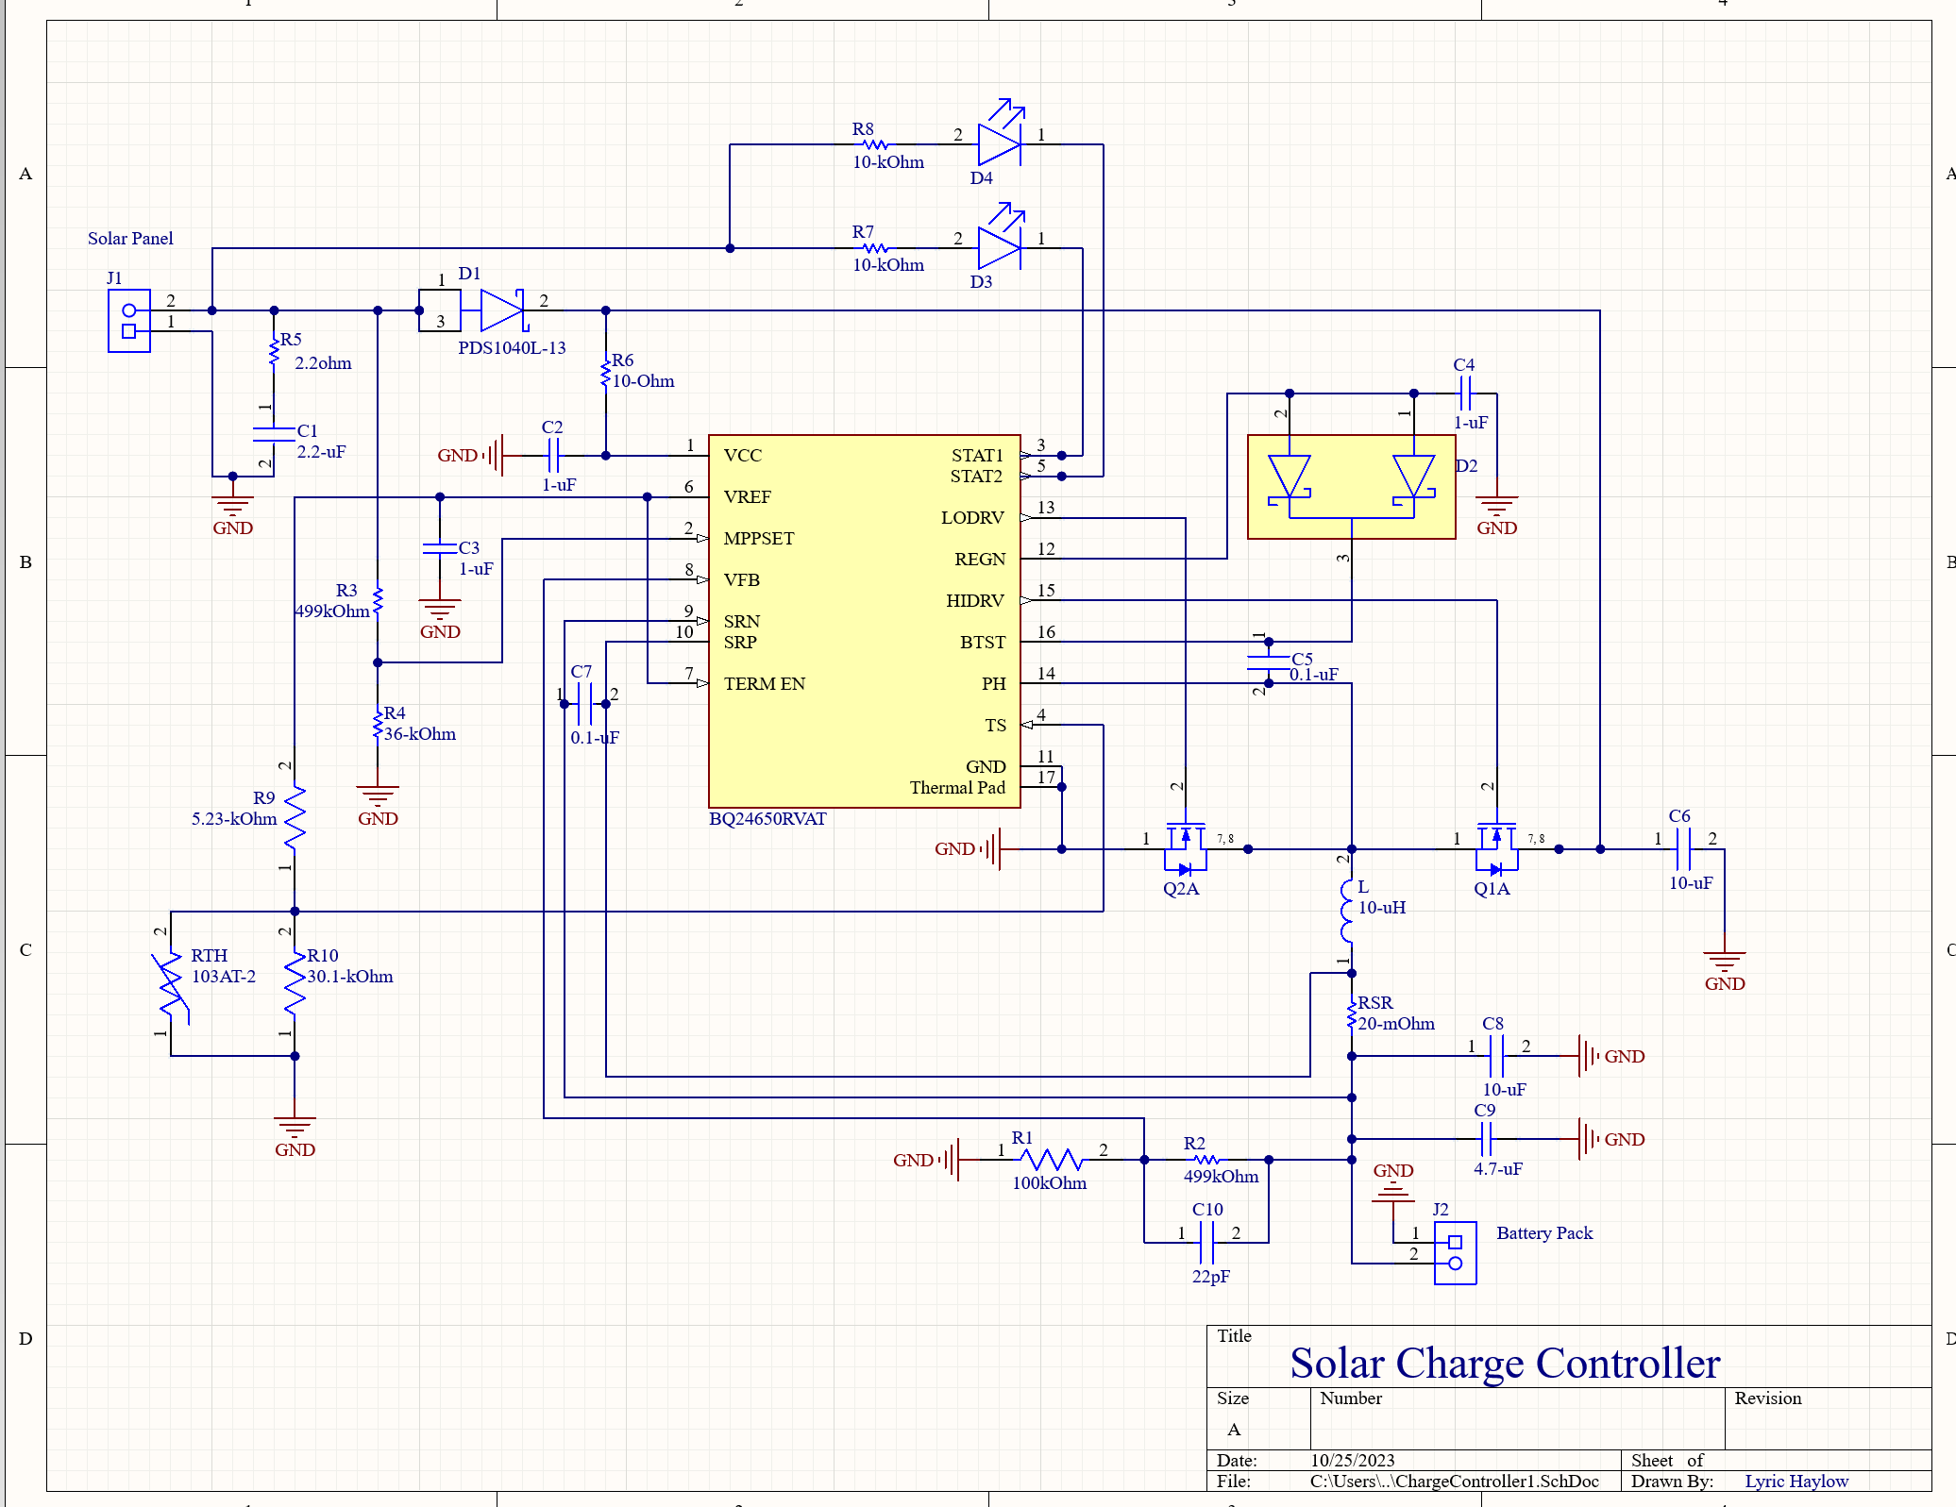
Schematic

Slide 9
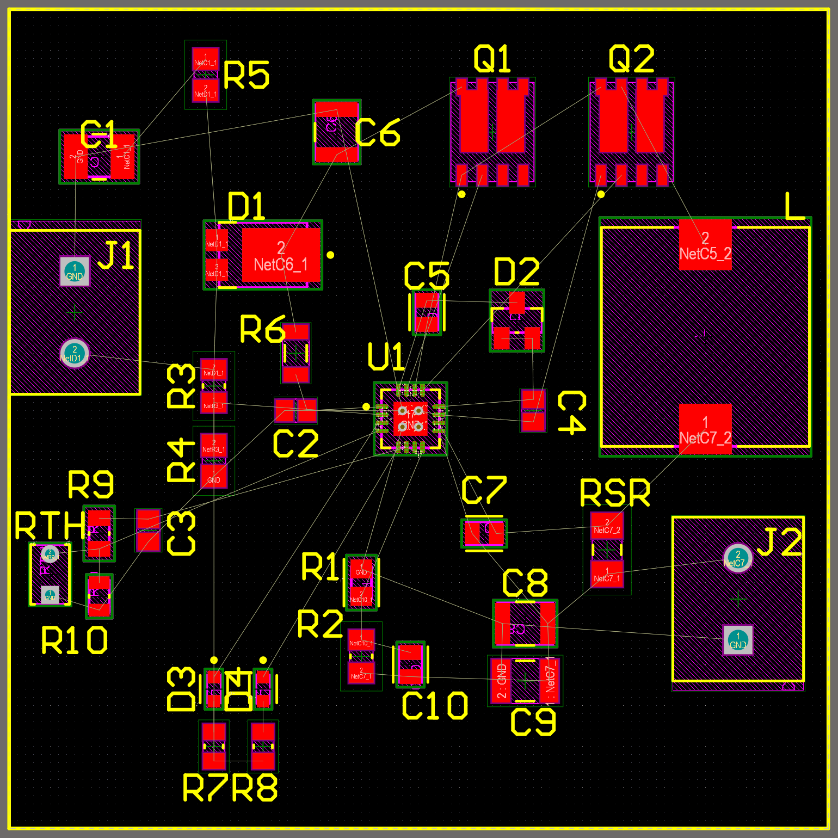
PCB
12- Board Size: 2000mils width
2000mils height
Resistor sizes set at 0805. Capacitors sizes from 0805 to 1210
To be done:
Add through holes
Trace routes

Slide 10
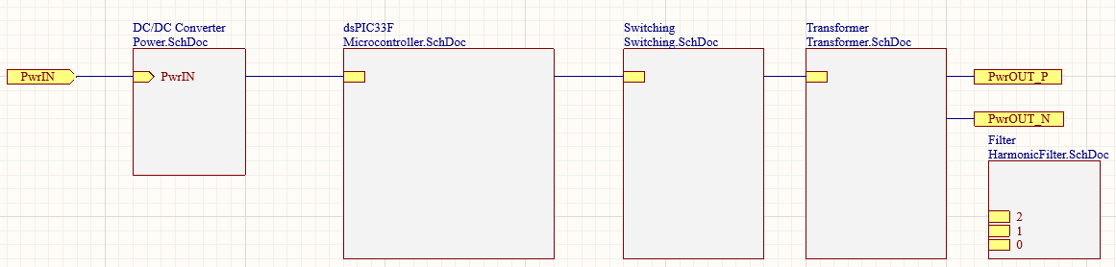
Power Inverter Jeb Malek
Accomplishments since the last presentation 36 hrs | Ongoing progress/problems and plans until the next presentation
PCB Design Progress Toroidal Transformer Ordered Following Grid-Connected Solar Microinverter Reference Design | Reference Design | Microchip Technology | Complete PCB Practice Solder E Load Validation Procedure Oscilloscope Benchmarking
Inverter Subsystem Diagram

Slide 11
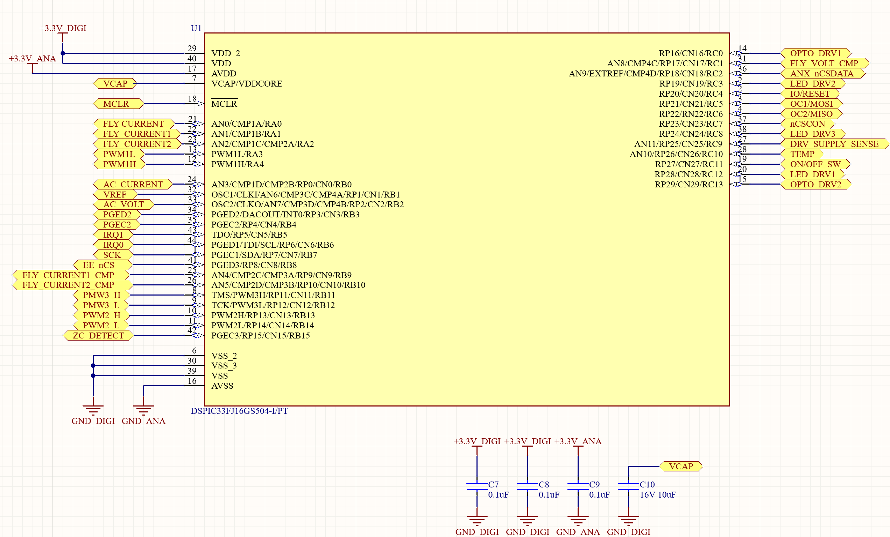
MCU Port Layout
Notes:
AND operator for signal at particular timing, comparator , using a triangular wave with , using the comparator and the triangle wave , pulses can be created

Slide 12
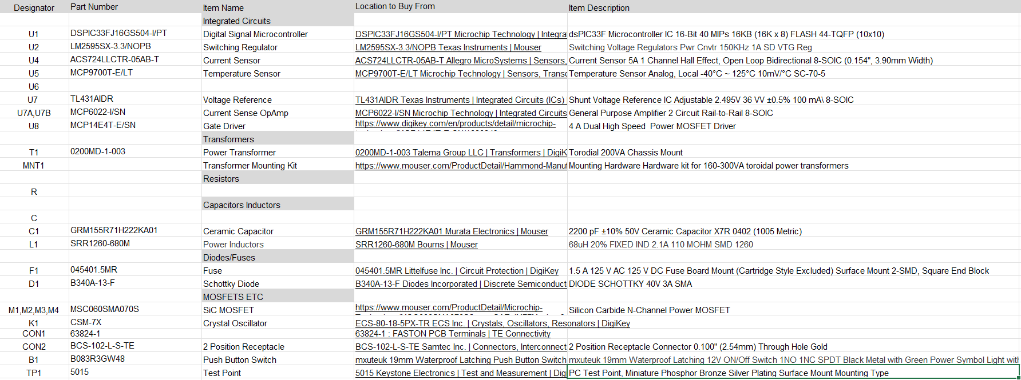
Part List
Notes:
50 percent on 50 percent off, half on , half off

Slide 13
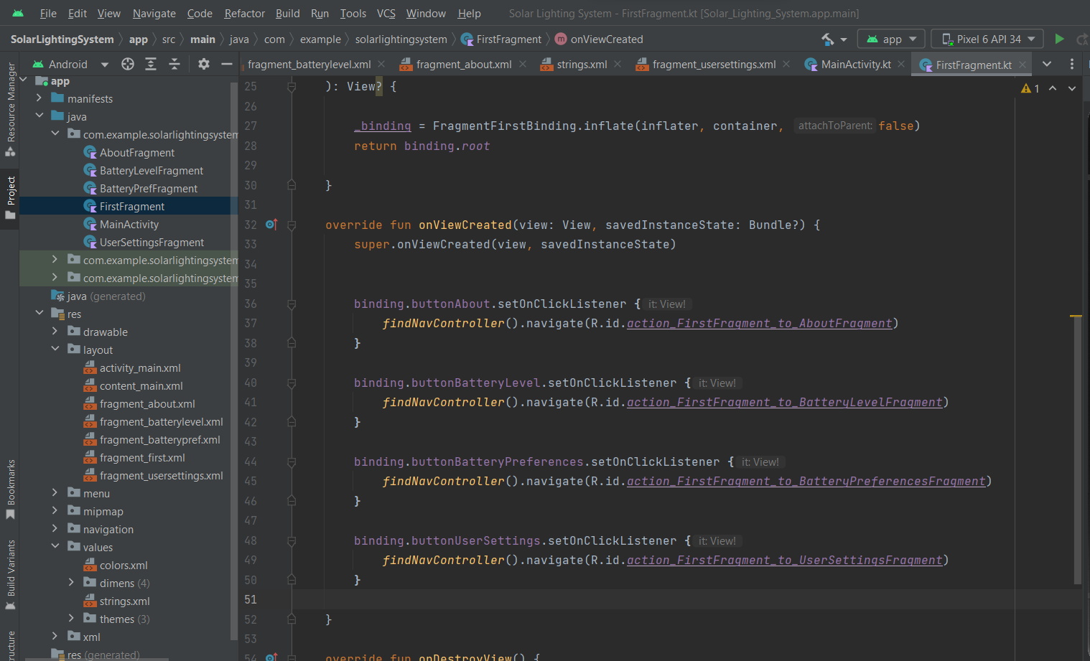
Android Josh George
Accomplishments since the last presentation 28 hrs | Ongoing progress/problems and plans until the next presentation
Home Screen Four Navigation Buttons About Screen User Settings Screen w/ Slider and Dropdowns | Connect to Microcontroller Obtain Battery Level (from MCU) Give User Preferences (from MCU) Obtain Weather Data from Online

Slide 14
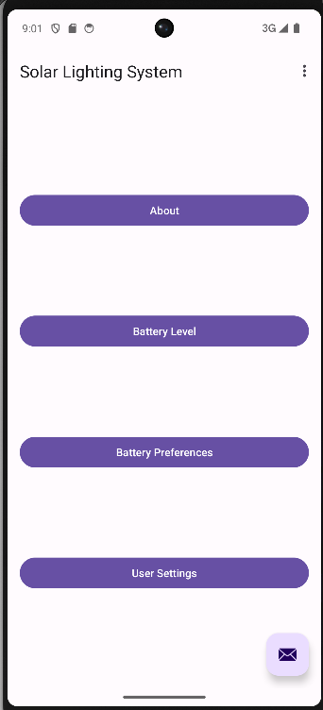
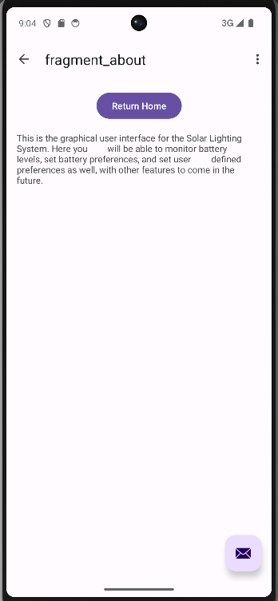
Mobile App Screenshots

Slide 15
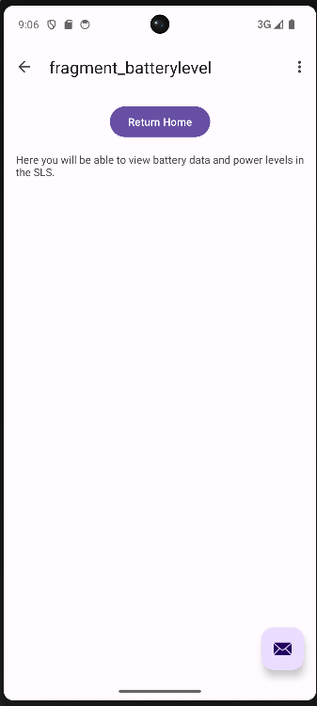
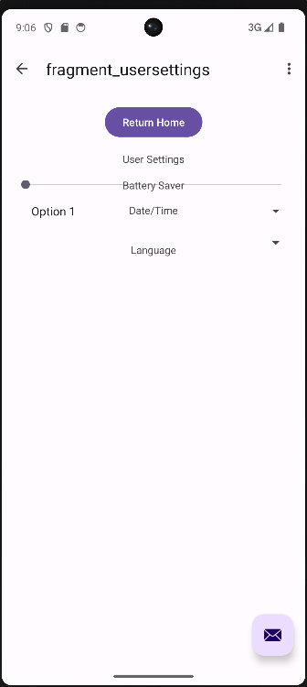
Mobile App Screenshots

Slide 16
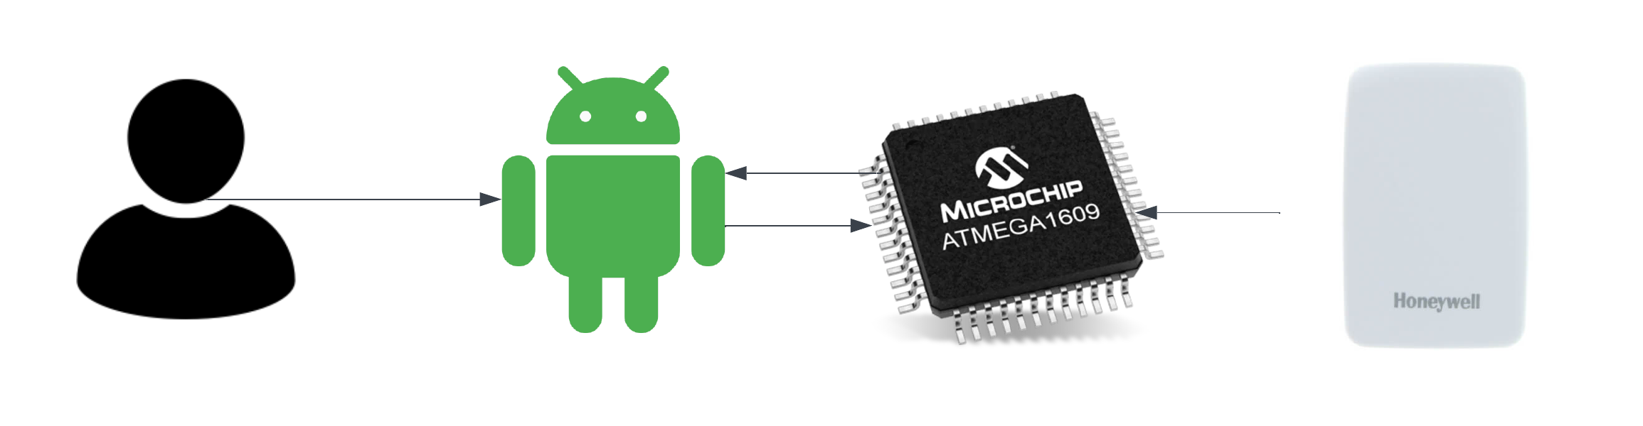
Mobile Application
Provides primary user interface for SLS
Programmed with Kotlin through Android Studio
Set user preferences, display battery/light data, display weather data
Connects to microcontroller serial port
Bluetooth connection

Slide 17
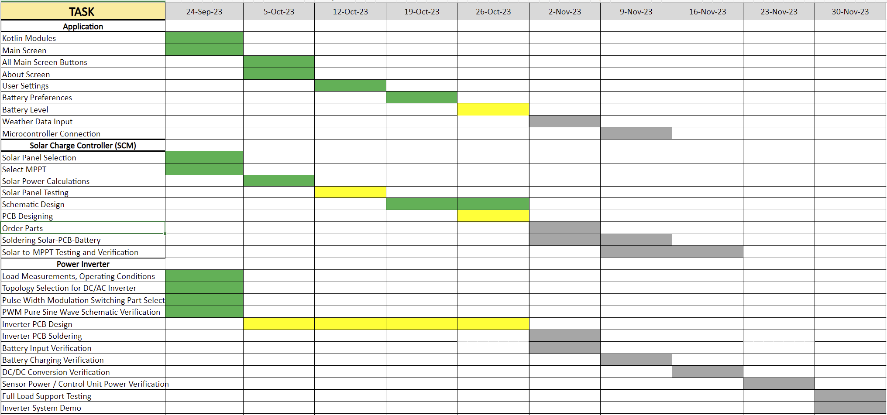
Execution Plan

Slide 18
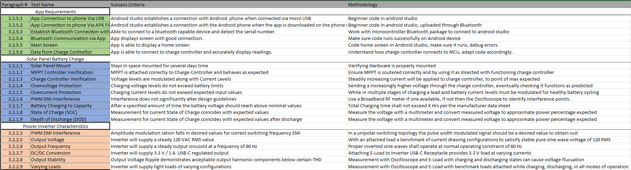
Validation

Slide 19
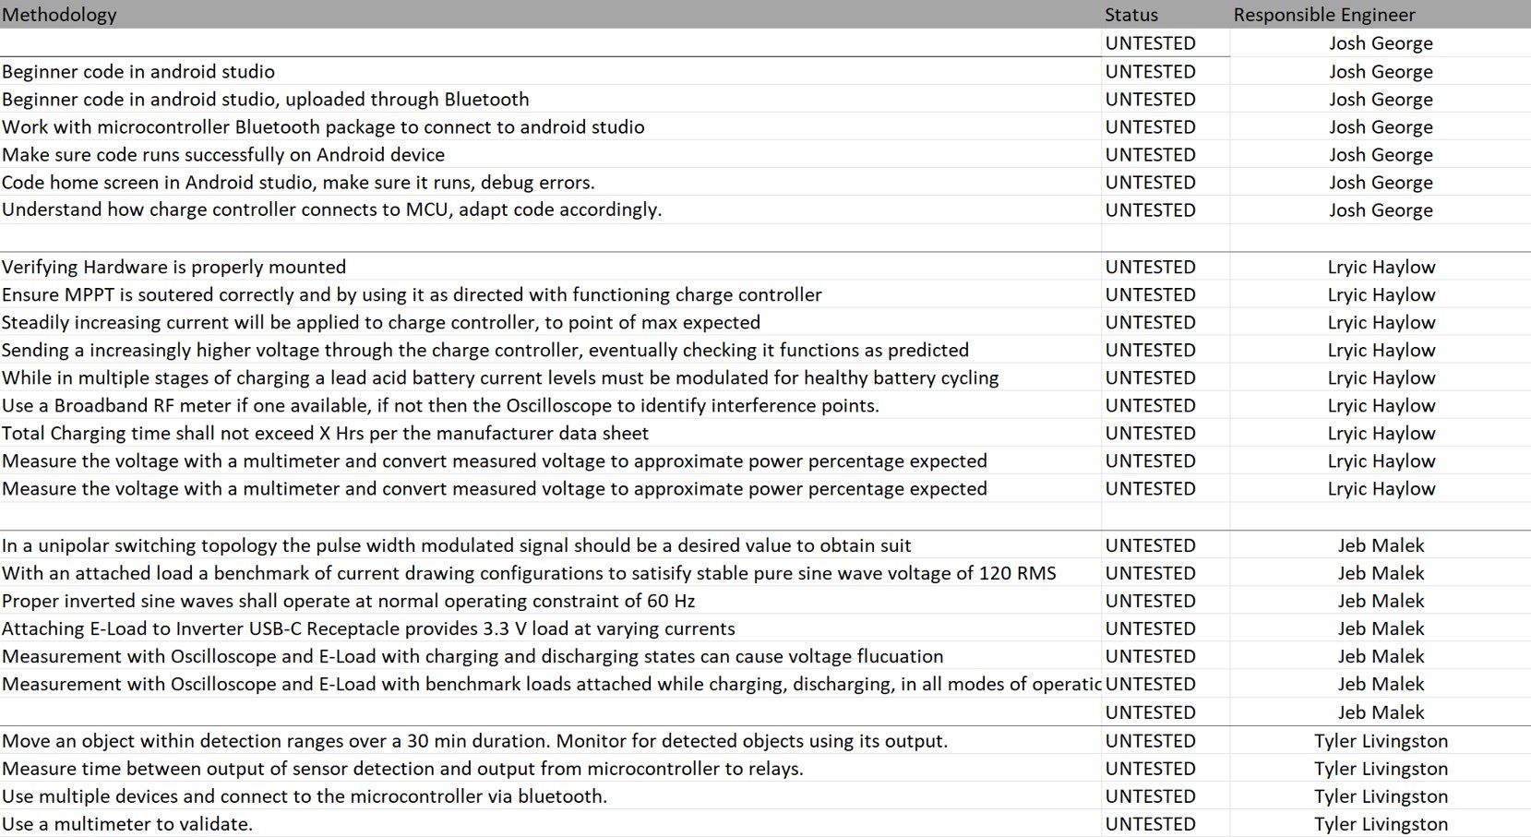
Validation

